Slide 1
P5.2 Demo: Exploration of the Effect of Task and User Role on the Evaluation of Interpretability Techniques
Annual Fall Meeting, New York, September 2018
Notes:
Welcome

Slide 2
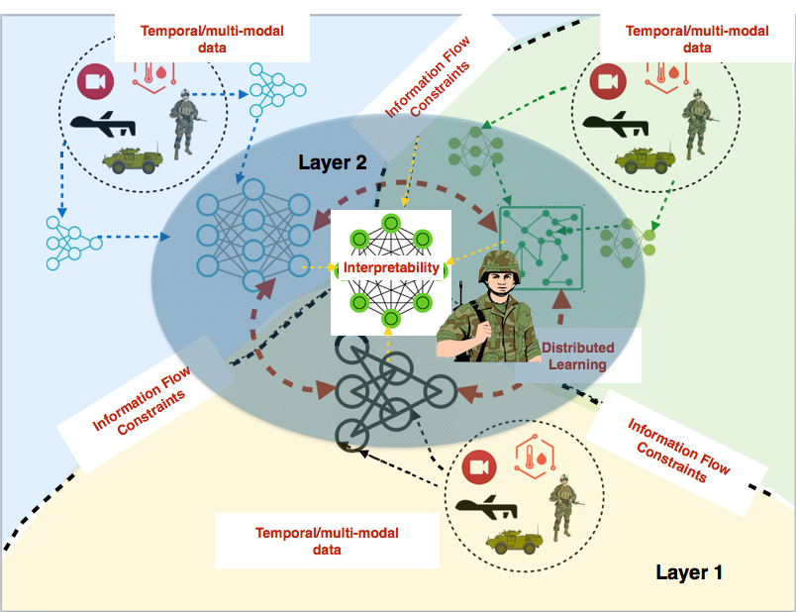

Motivation – Coalition Situational Understanding (CSU)
Credit: U.S. Army/Sgt. Edwin Bridges)
In IPP6, we established 5 key features of CSU.
In BPP5.2, interpretability of decision support models has been our focus.
Notes:
“I’ll start with some background about the work we’ve been doing in Project 5.2”
On the back of research from IPP6 we’ve been continuing our look at coalition situational understanding.
Within CSU, we outlined 5 aspects that were important , one of which was the interpretability of the decision support being provided by CSU systems.
In BPP5.2 we have focused on assessing the state of the art of interpretability with the aim to develop a formal metric for analyzing

Slide 3
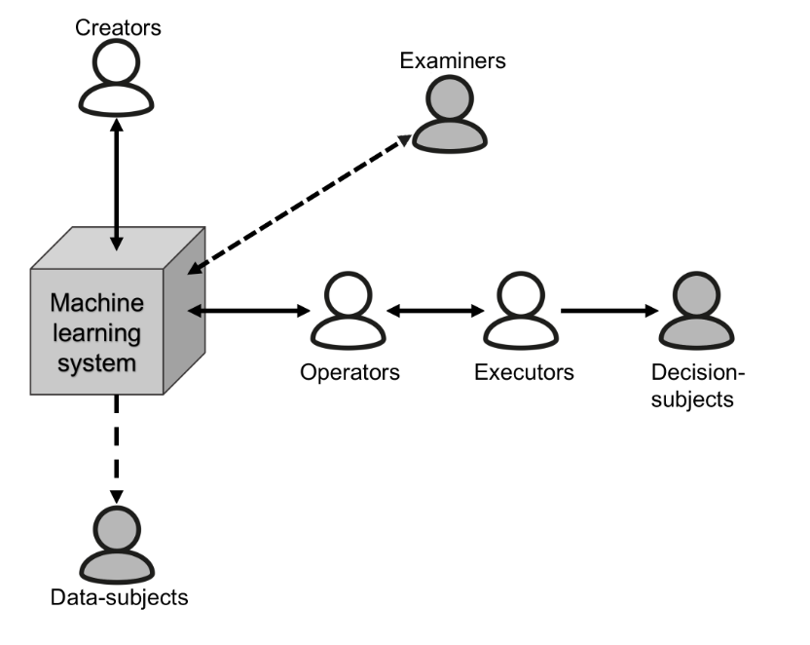
An agent’s role/relationship with a machine learning decision will effect the utility of interpretability techniques.
User Knowledge may effect the details that can be provided within explanations.
Task of the agent may effect what information is useable.

Slide 4
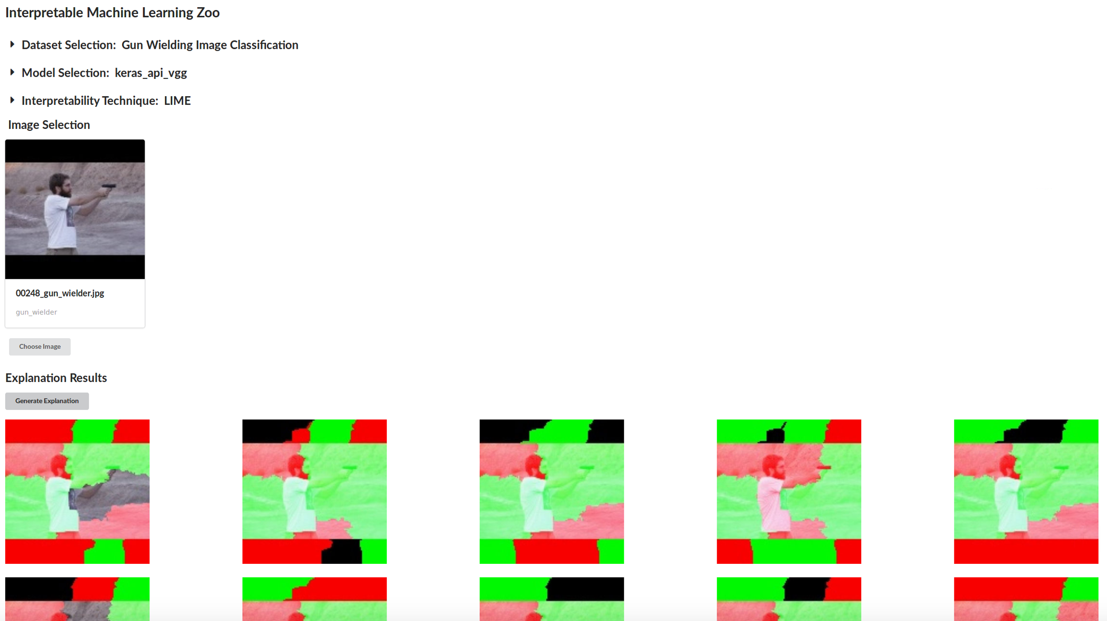
This demo showcases a framework developed that brings:
Easy Comparison of existing (and new) interpretability techniques.
Generating Data for experiments both analytical and human based testing.
Sharable Tool that through open-sourcing can help engage the wider Machine Learning community.
Notes:
The framework
bringing together datasets, models and explanation techniques
Datasets are self curated and famous existing benchmarking
Models are self created and famous existing algorithms and architectures
Techniques are popular existing techniques with the hope that we can add our novel techniques to bench mark them

Slide 5
Experimentation Framework - Datasets, Models and Explanations
Datasets
Gun Wielder Classification
Traffic Congestion
CIFAR-10
MNIST
ImageNet
Models
Neural Networks:
VGG16
VGG19
InceptionV3
Inception ResNet V2
MobileNet
Xception
Other Models:
Support Vector Machine
Explanation Techniques
LIME
Shapely
Deep Taylor LRP
Influence Functions
Notes:
Current items in the framework
A range of items we’ve used in previous research as well as a range of popular datasets used for benchmarking and model architectures that have been shown to perform well against different benchmarks and in competitions as well as in practical applications.
The interpretability techniques are one receiving a lot of attention within the ML community.
This list is just the items we have currently, a bit later in the demo we’ll show the architecture behind the framework and discuss the ease at which items can be added.

Slide 6
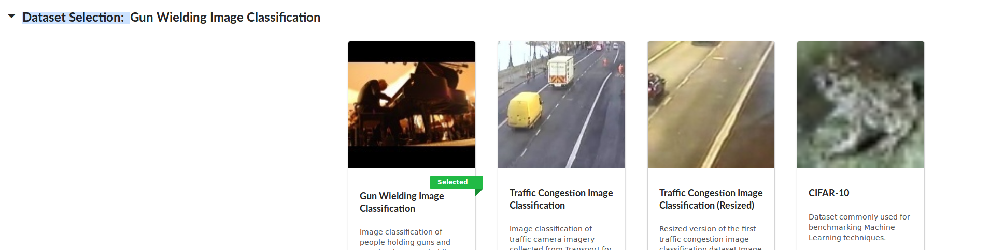
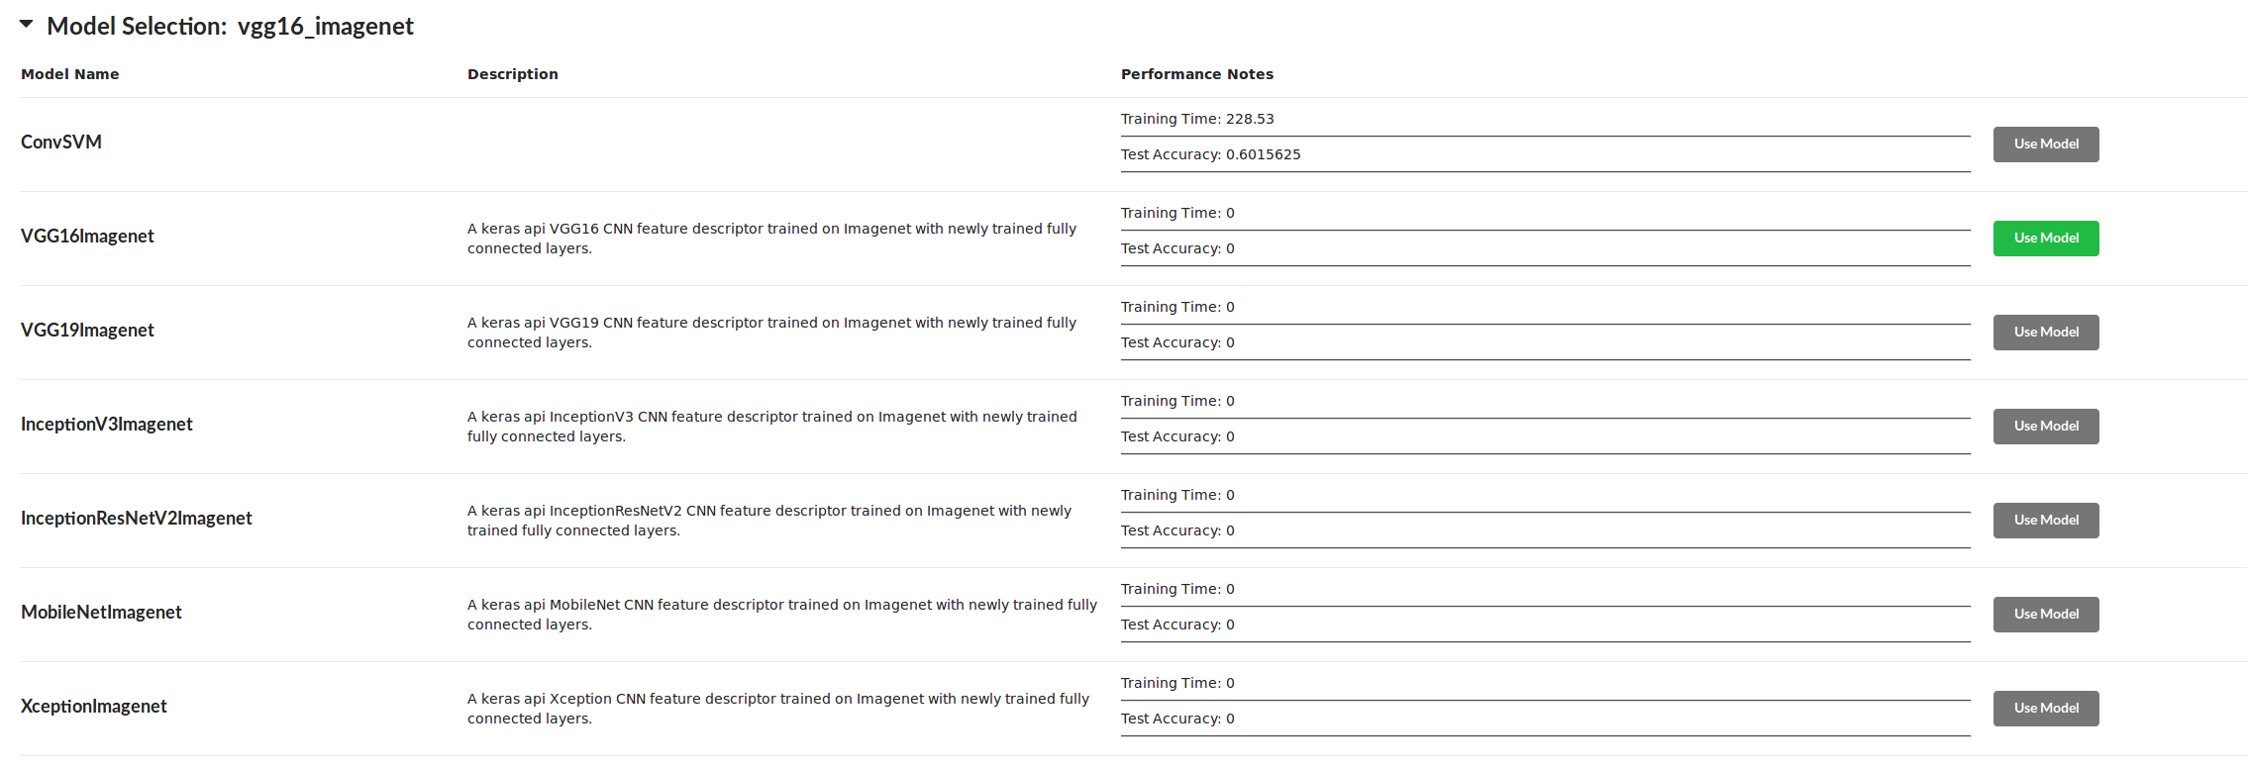
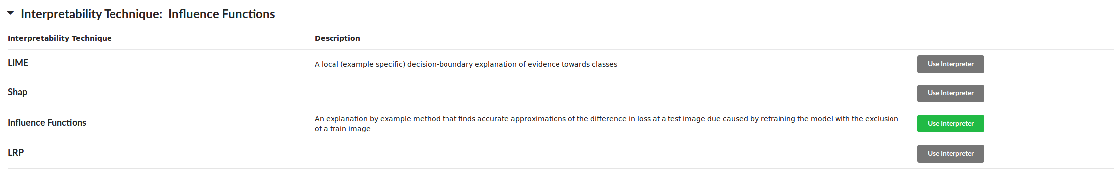
Experimentation Framework - Datasets, Models and Explanations

Slide 7
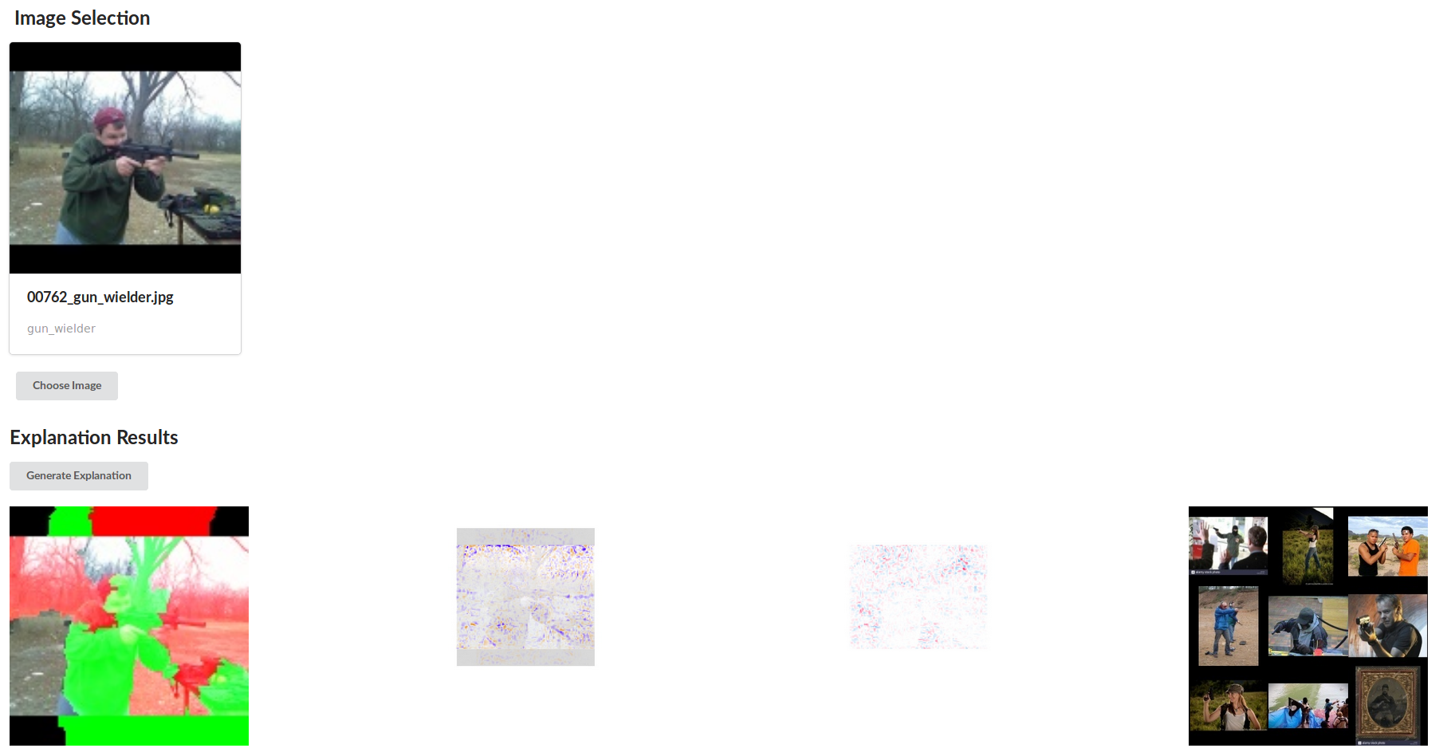
Use Case 1 – Multiple Explanation Techniques on the Same Input:
Experimentation Framework – Use Cases
Build Intuition for different techniques.
Compare Utility of different techniques – do different users (with different roles/knowledge) prefer different techniques.
Notes:
Use Cases
One model, multiple techniques , compare the outputs. In the context of looking for metrics or looking for viable decision support techniques,
Researchers can quickly use it to generate data to show to subject matter experts.
It’s also available and easy to use so SMEs or non-ML-trained researchers can use it and build their own intuitions or conduct research

Slide 8
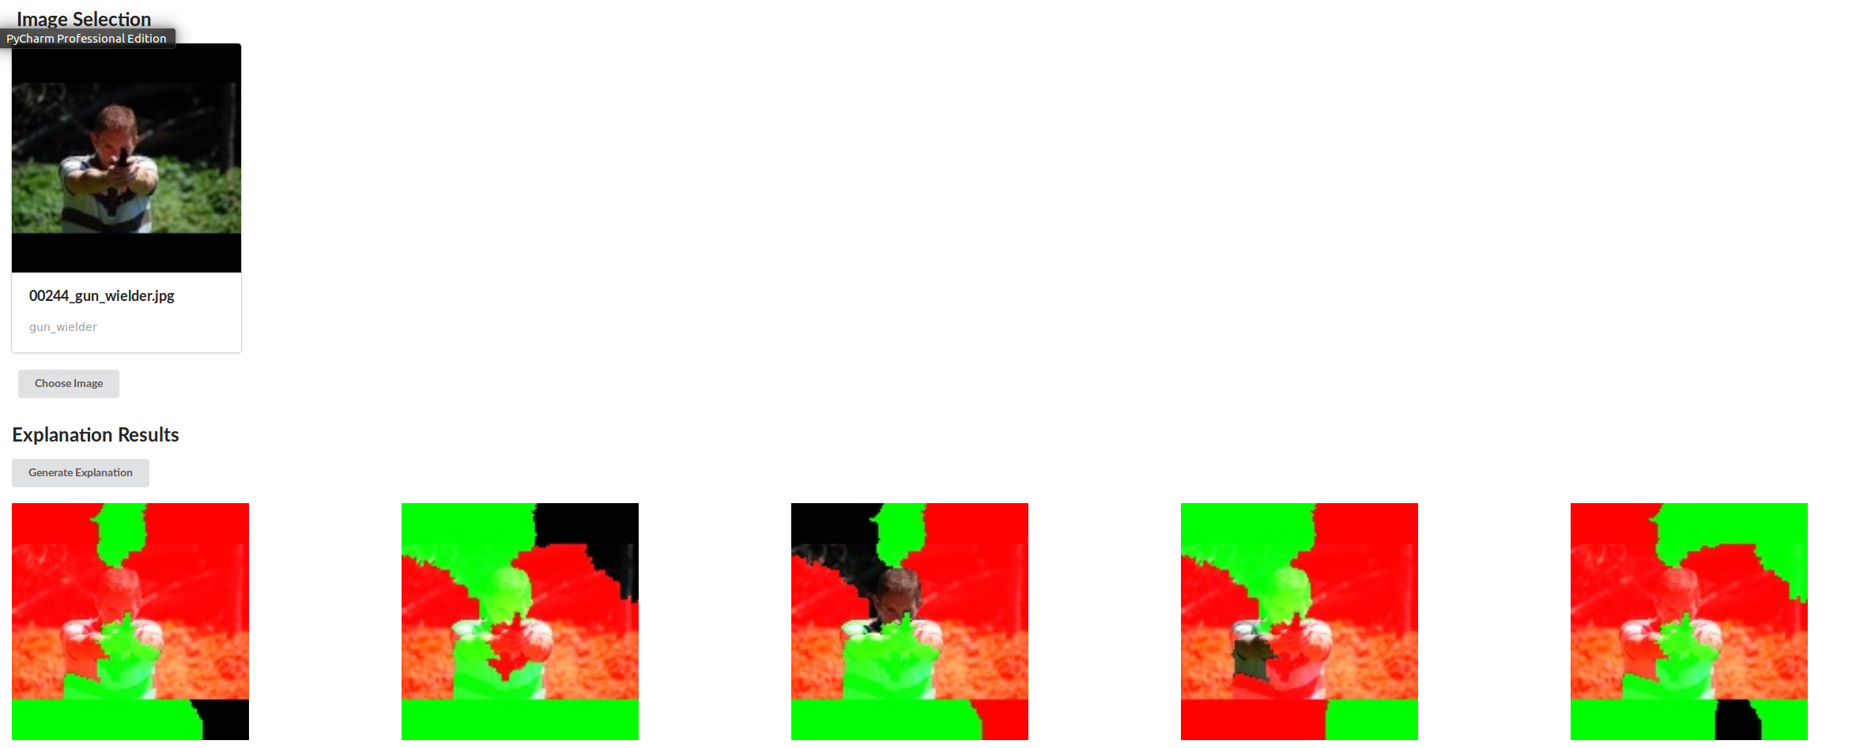
Use Case 2 – Multiple Explanations from the Same Technique:
Experimentation Framework – Use Cases
Build Intuition for how stable the technique is.
Generating Data for experiments.
Refine techniques as seen in collaborative work with West Point cadets.
Notes:
One model multiple explanations from same technique, spots instability
West Point cadet work
Non ML trained but know python

Slide 9
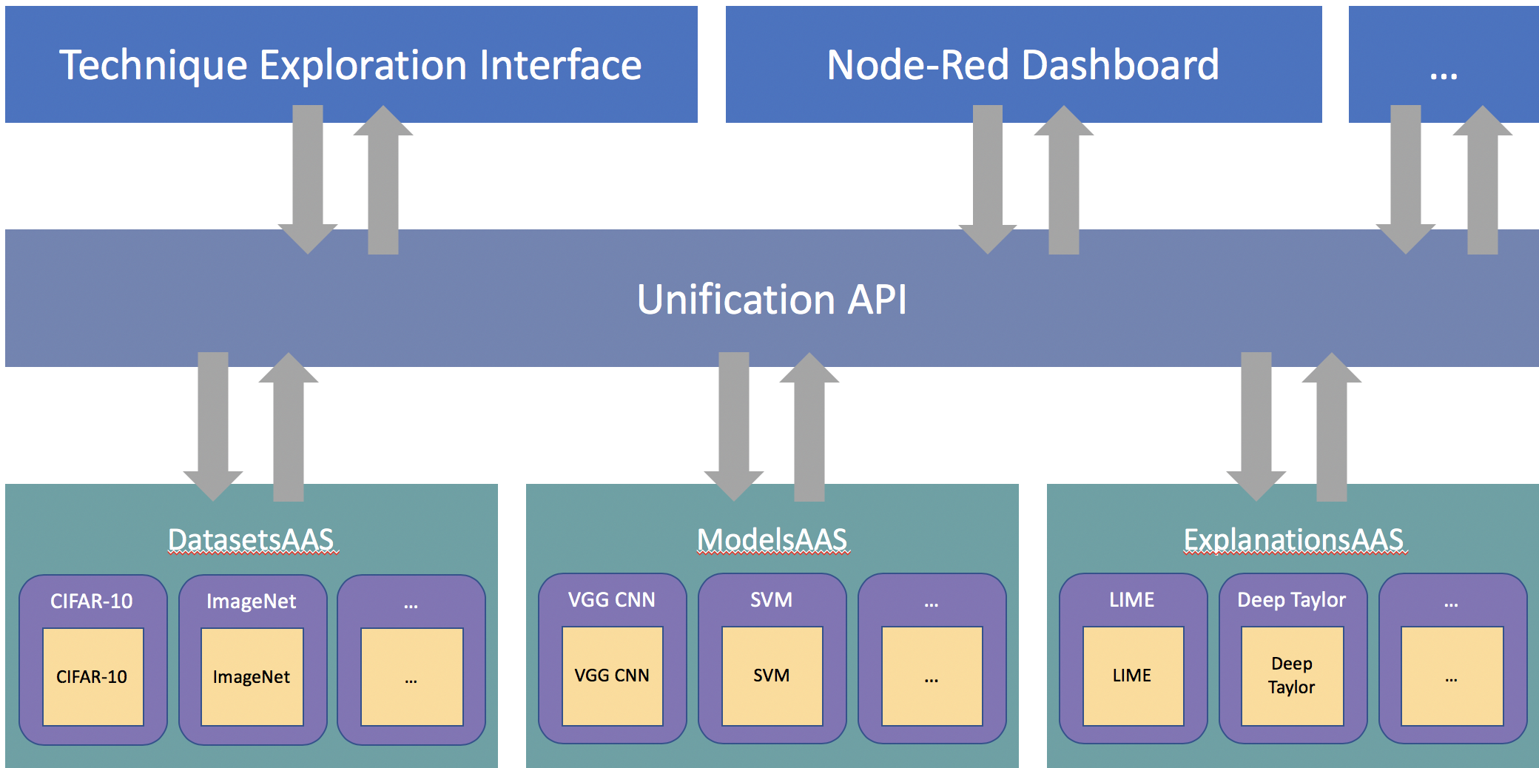
Experimentation Framework - Architecture
Open-sourced at: github.com/dais-ita/interpretability_framework
Notes:
Those two use cases are particularly relevant to that specific interface. As mentioned previously, the interface is decoupled from the lower layers of the framework. This means if you have a specific requirement, perhaps you need to present data in a specific way to perform focus groups with subject matter experts, perform trials with human participants or present the interface in a different medium such as via a conversational interface, it’s very eay to make use of the API seen in the middle layer of this diagram, and build an interface.
OPTIONAL- Architecture and Design
3 decoupled layers
Wrapper class give uniform I/O to datasets , models and explanations
Flask services make these queryable and handle the dataflow and execution
A unified API gives a easy request based way to access the items in the frame work
The API allows for the final layer consisting of a user interface to be built decoupled from the framework allowing for different interface types to be built and customised to meet the needs of the researchers or the study

Slide 10
Framework - Summary
Notes:
In Summry
the framework will be an invaluable tool for
building our intuitions
Benchmarking techniques
Generating data for human studies
Open sourced so we can engage with the larger community

